Slide 1
Forage Platform Data@ANZ Data Science Virtual Internship
By: Aishwarya Prakash Dhalagade
M.Tech (Control System) – VJTI Mumbai,India.
Email Id: aishwaryadhalagade@gmail.com
Contact no: 8208624946
Linkedin Profile: https://www.linkedin.com/in/aishwarya-dhalagade-7853451a1

Slide 2
Tasks Provided:
Task – 1 : Exploratory Data Analysis
Segmenting the dataset and obtaining unique insights from it, including visualization of the transaction volume and assessing the effects of any outliers.
Task – 2 : Predictive Analysis
Exploring correlations between customers attributes, building a regression and decision tree prediction model based on findings in dataset.
Dataset :
ANZ synthesised transaction dataset containing 3 month’s worth of transaction for 100 customers, Consisting purchases, recurring transactions and salary transactions.

Slide 3
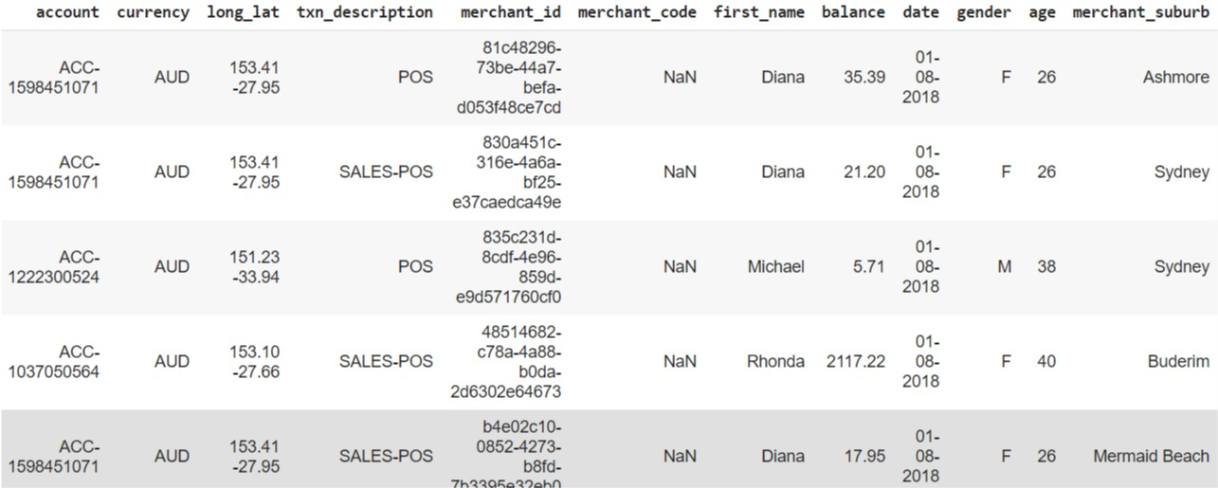
Exploratory Data Analysis
ANZ synthesised transaction dataset : Shape – (12043, 23), Contains around 12 thousand entries of transaction (rows) and having 23 attributes.
Below representing first five rows of the dataset, containing some attributes.

Slide 4
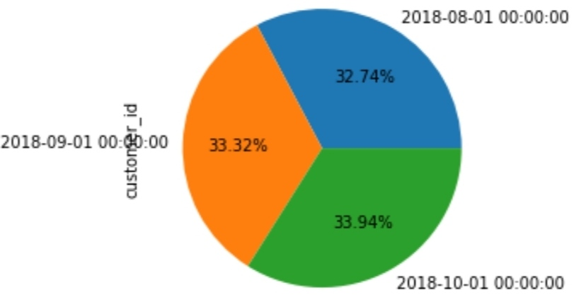
Primitive Findings :
Each of the customer from 100 total, have separate account detail, that means the complete 12000 transactions are done within these 100 customers account.
The average (mean) transaction amount : 187.933 AUD
Transactions done by customers in each months of average basis :
3 months are : August, September, October 2018.
Aug : 3943 AUD
Sept : 4013 AUD
Oct : 4087 AUD
Fig. Total transaction
Distribution (%) for each
Month.

Slide 5
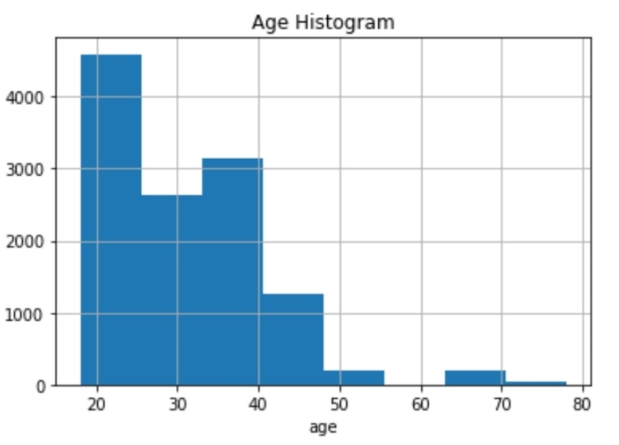
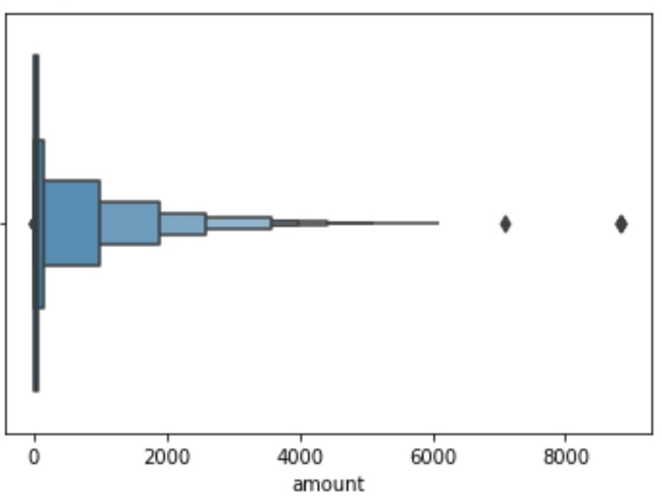
Customer’s Age Distribution:
Most of the customers are majorly in
between 20 - 25, and furtherly In 25 – 40.
Then percentage of customers above
age of 40 decreases.
Fig. shows Age distribution Histogram.
Amount Distribution:
Customer’s transactions, Its Amount
is distributed as shown In given Boxplot.
Majorly transaction is done below
1000 AUD, and then its faded as
Amount increases.
Fig. also shows 2 outliers, having
Amount value greater then usual.

Slide 6
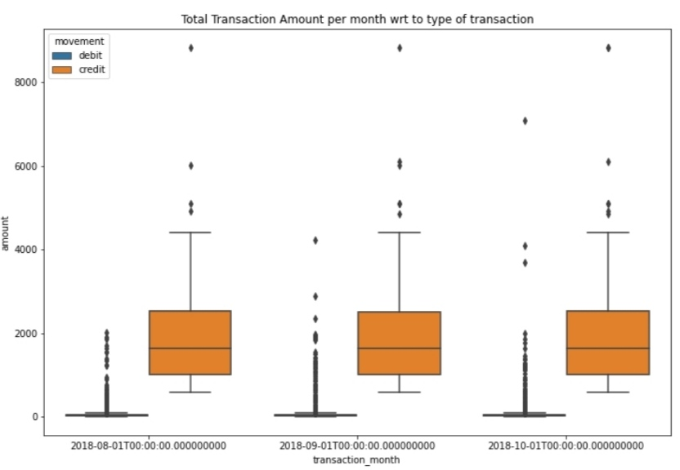
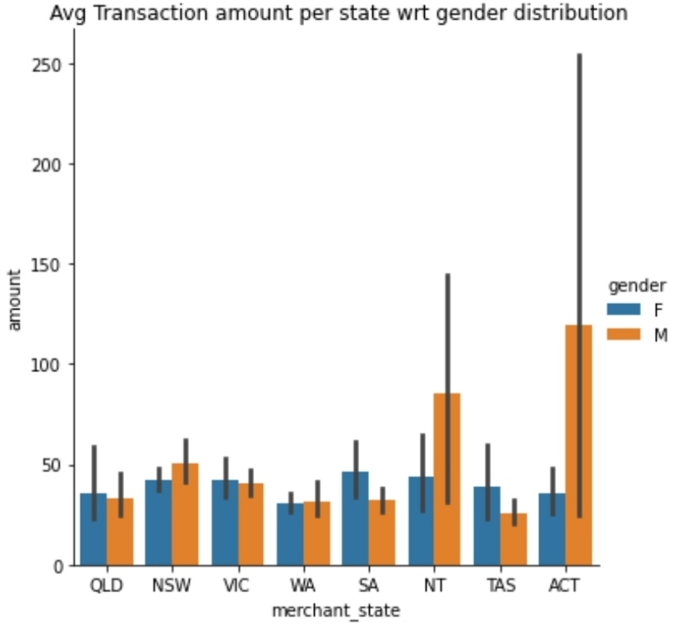
Transactions per month:
Total transactions amount per Month
with respect to type of Transaction
(debit or credit).
Boxplot shows almost all months Have
same transactions, but october is
representing slightly greater.
Mostly customers prefer debit Card.
Transaction Per state :
Average transaction amount per
state with respect to gender distribution.
Total 8 states are in Australia,
transactions in ACT and NT states are
bit higher than other, and mostly,
Male customers done more transactions .
In other states, ratio is almost same.

Slide 7
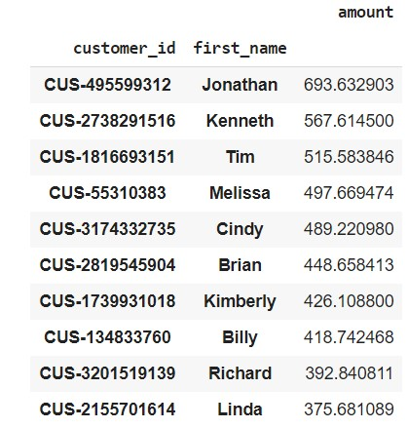
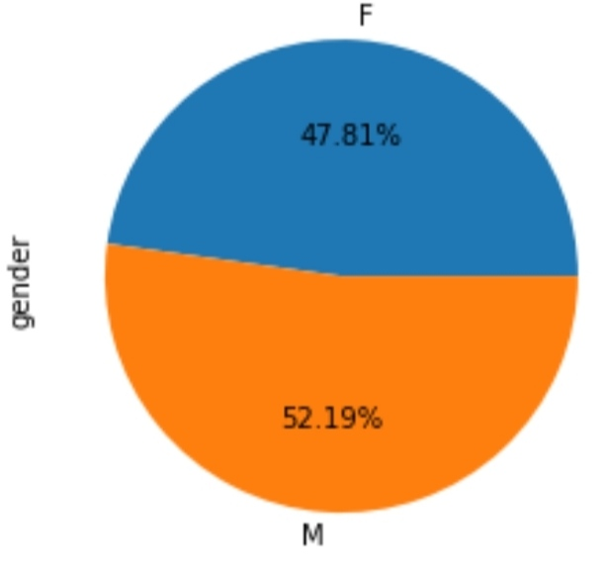
Top Ten Customers:
Following is list of 10 customers,
Grouped with respect to average
transactions Amount by these
customers in 3 months Period.
Sorted in Descending order.
Customer’s Gender Distribution :
Total 100 customers distributed
Using pie chart, Male customers are
Bit greater than female.

Slide 8
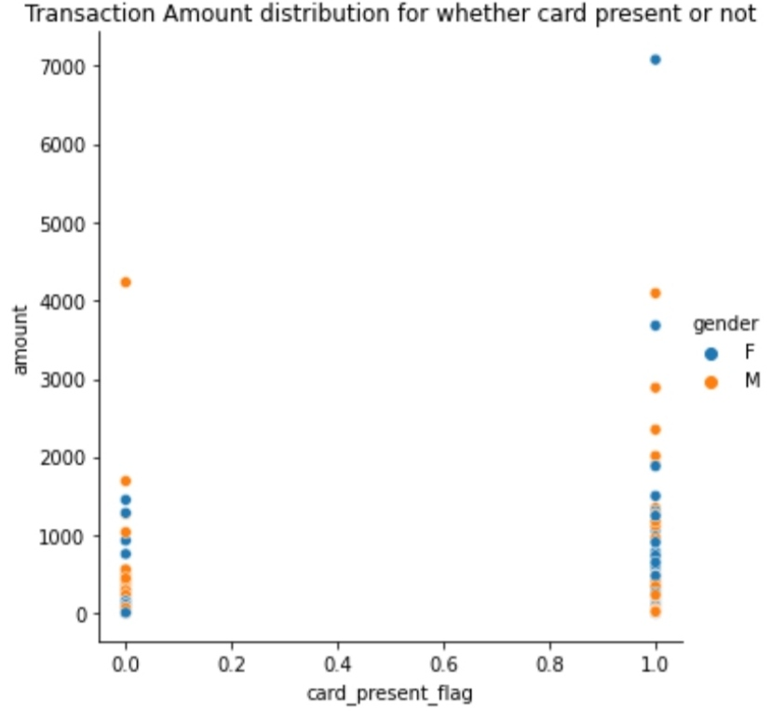
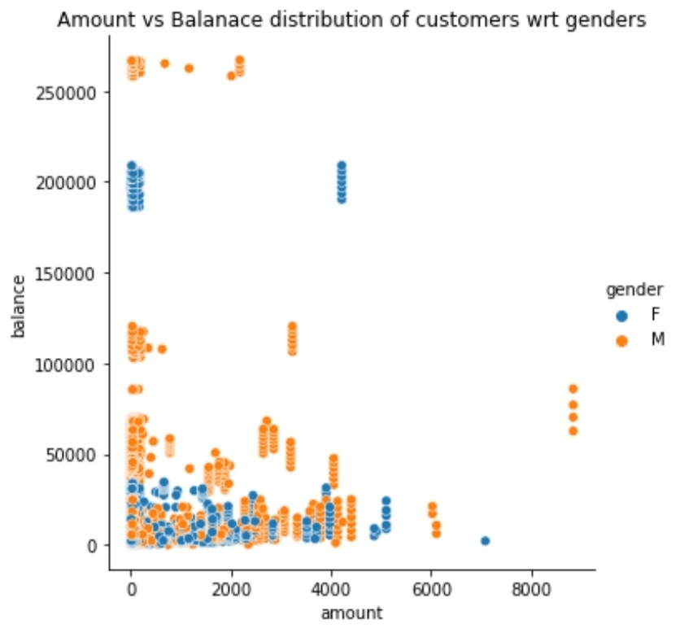
Fig. Amount vs Balance distribution of customers with respect to genders. From Observation, Account Balance of customers are mainly in between 0 – 100000 AUD, and they are most likely done transactions of amount below 4000 AUD in general. also they are some outliers having balance greater than 150000 AUD, but with low (less than 500 AUD) transaction rate. Male customers are more. Fig. Transaction Amount distribution for whether card present or not. 0 – not present flag, 1 – present flag. From observation, customers having card are usually done more transactions in quantity and amount.

Slide 9
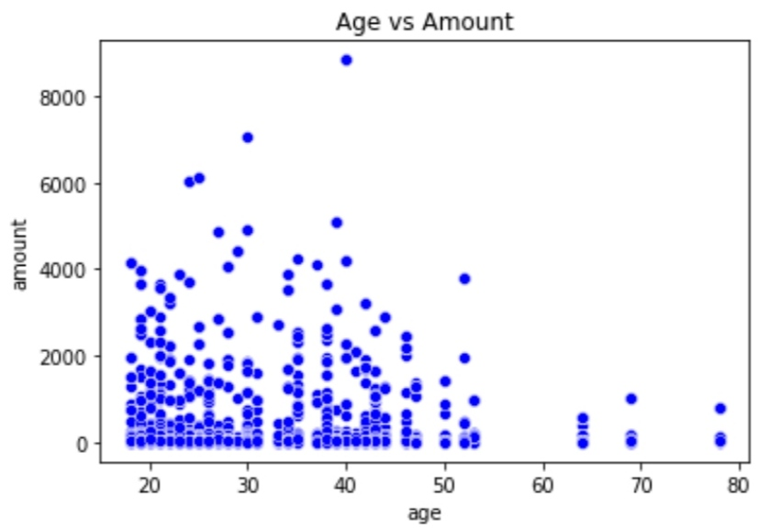
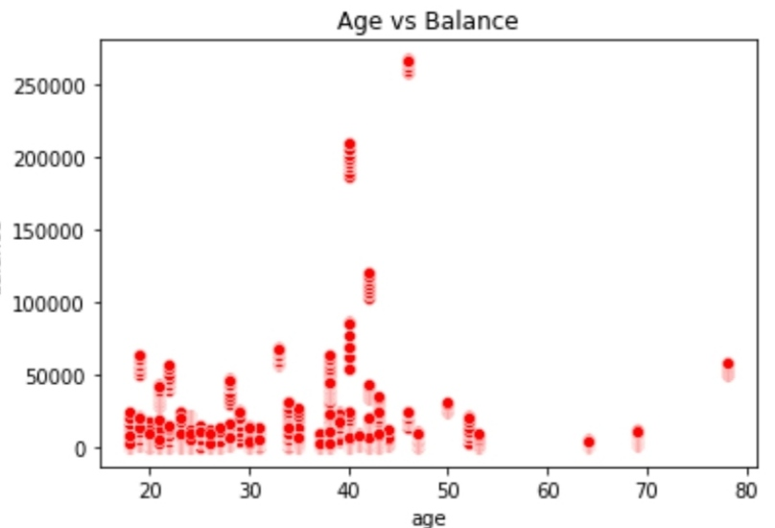
Age vs. Amount :
Fig. shows scatter plot representing relation
between age and transaction amount.
Customers in age range of 20-30, and 35-45
is most likely to done transactions around
amount below 1000 AUD. Also these customers
sometimes tends to extend their transactions
from 1000 – 4000 AUD.
Age Vs. Balance (account) :
Fig. shows scatter plot representing relation
between age and account balance.
Here also, Customers in age range of 20-30,
and 35-45 most likely to have balance below
50000 AUD, there are some outliers, As in the age
between 35-45 account balance for some
customers are above 50000 AUD to 200000 AUD.

Slide 10
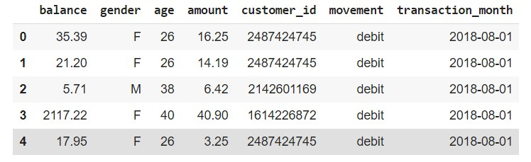
Predictive Analysis : Features and Output.
Out of total 23 attributes in dataset, selecting 6 as features, (attributes giving high evaluation after model training on those) and 1 as output obtained from predictions on model.
Fig. shows first 5 rows of new dataset obtained by data pre-proccesing on original.
X (features) – balance, age, amount, customer-id, movement, transaction month; y (output) – amount.
Splitting the obtained dataset into Training and Test set for model with 80% - data for training and 20% data for test split.

Slide 11
Predictive model 1 : Multiple Linear Regression model.
From ‘sklearn.linear_model’ module importing ‘LinearRegression’, Model is trained on X_train, y_train.
Evaluation of above model is done on Test data using ‘r2_score metrix’ obtained from ‘sklearn.metrics’ module, close the value to 1, better the performance of model.
r2_score : 0.675 (Multiple Linear Regression model)
Predictive model 2 : Decision Tree Regression model.
From ‘sklearn.tree’ module importing ‘DecisionTreeRegressor’ Model is trained on X_train, y_train.
Evaluation of above model is done on Test data using ‘r2_score metrix’ obtained from ‘sklearn.metrics’ module, close the value to 1, better the performance of model.
r2_score : 0.803 (Decision Tree Regression model)

Slide 12
Conclusion:
Complete Exploratory Data Analysis and Predictive Analysis performed on the dataset ‘ANZ synthesised transaction.
Data visualization is done on very attributes of the dataset, representing univariate and bivariate relationship between attributes.
Multiple regression and decision tree prediction model for predicting the transaction amount using the selected features for better performance of model.
Out of two models, Decision tree model shows better evaluation on test data (unseen data by model).

Slide 13
Thank you…

